Slide 1
SQL Server 2016 Database Administration for the Non-DBA
Denny Cherry
mrdenny@dcac.co
www.dcac.co
twitter.com/mrdenny

Slide 2
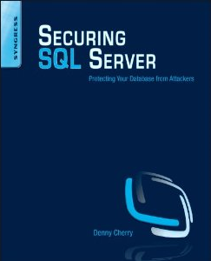
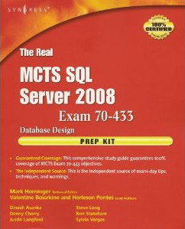

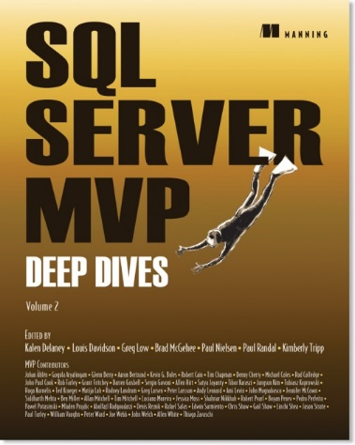



About Me
Denny Cherry & Associates Consulting
6 books
Dozens of articles
Microsoft MVP
Microsoft Certified Master
VMware vExpert

Slide 3
Agenda
Files, File Groups, Disks
Backups
Recovery Model
Database Maintenance
Compression
Corruption
Compatibility Level
Indexes
Query Store

Slide 4

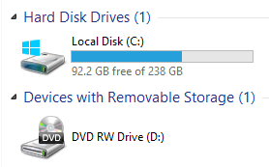
Files, File Groups, Disks
File Groups are made up of files
Files hold the data
Disks Hold Files
http://www.flickr.com/photos/photomequickbooth/4011249096/

Slide 5
Files, File Groups, Disks
Each database is made up of at least two files
One file is data
One file is transaction log
http://www.flickr.com/photos/photomequickbooth/4011249096/
Notes:
The data file contains all of the data within the database. The transaction log contains a record of every change which has been made to the database since the last time the transaction log was truncated. Depending on the recovery model of the database (we’ll talk more about recovery models in a few slides) when the transaction log is cleared will change.
There can be multiple data files for a single database, and there can be multiple transaction log files for a database. In some situations having multiple data files can give you a performance increase, however it isn’t needed. I’ve got customers who have multi-terabyte databases which are just a single physical file. There is no performance increase for having multiple transaction log files. There are some edge cases where having multiple transaction log files can be helpful, however in 99.999% of cases there is no need.

Slide 6
Backups
3 Different Kinds of Backups
Full Backups
Differential Backups
Transaction Log Backups
Advanced Backup Options
File Group Backups
Backups Saved On Another Machine
http://www.flickr.com/photos/gemstone/406866312/
Notes:
How often full, differential and transaction log backups should be taken totally depends on how much data you as a company are willing to loose in the event of a major database failure. It is often the case that within a company there will be some databases which you can afford to loose more data from than others.

Slide 7
Full Backups
Makes a point in time copy of the database
Database is in the state the database was at the end of the backup
Should be done daily or weekly

Slide 8
Differential Backups
All extents which have changed since the last full backup
Each differential backup will get bigger until the next full backup
Uses the differential bitmap page to figure out what to backup

Slide 9
Log Backups
Backups up the records from the transaction log
Only used will full or bulk-logged recovery model
Allows log records to be overwritten
Should be taken frequently
Frequency should be determined by SLA (RPO)

Slide 10
Recovery Models
Three Recovery Models Available
Simple
Bulk-Logged
Full
Used to control amount of logging
http://www.flickr.com/photos/decade_null/142235888/

Slide 11
Simple Recovery Model
Minimal Logging
No Point In Time Recovery
Does Not Disable Logging
http://www.flickr.com/photos/noii/1337970464/
Notes:
When the database is in the simple recovery model the transaction log is truncated about once a minute.

Slide 12
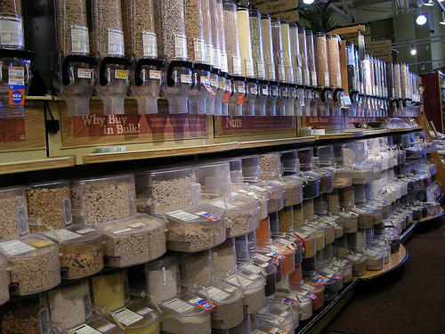
Bulk Logged Recovery Model
Some commands are bulk logged
Most commands are fully logged
Point In Time Recovery Supported
http://www.flickr.com/photos/4nitsirk/3778043845/
Notes:
When the database is in full recovery mode or bulk logged recovery the transaction log will only be cleared when a transaction log backup is completed.

Slide 13

Full Recovery
Almost nothing is bulk logged
Point in time recovery is supported
Full Data Protection
http://www.flickr.com/photos/usarmyafrica/5536713055/

Slide 14

Restoring Data
Full Restore
Differential Restore
Transaction Log Restore
Page Level Restore
File Group Restore
http://www.flickr.com/photos/fun_flying/2959307155/
Notes:
The goal when restoring data is to get the database into the exact state that it was at the time when that backup was taken. By using transaction log backups as well as full backups (and if available differential backups) we can restore a database to what ever point in time that we want. A restore operation when using the transaction log can be restored to one thousandth of a second. This allows for very precise control when restoring a database which has had database deleted as you can restore until just before the moment when the data was deleted to ensure that you get every data change until just before the deletion was done.
In the event of data corruption (we’ll talk more about data corruption later) you can restore just the data page which has been corrupted by first restoring that page from the full backup, then restoring the transaction log backups. The SQL Server will see that the few pages which are being restored our the only ones which are out of sync with the rest of the database and they will be the only pages which are restored. On large databases restoring just a few database pages will be much faster than restoring the entire database.

Slide 15

Database Maintenance
Databases need TLC
Index Rebuilding
Index Defragmenting
Update Statistics
http://www.flickr.com/photos/wjlonien/6309343565/

Slide 16
Database Maintenance
Index Rebuild
Index Defrag
Can be online or offline depending on version, edition and column data types
Creates new indexes then drops old index
Updates Statistics on index
Always Online
Moves data around pages row by row
Only moves rows that need to be moved
http://www.flickr.com/photos/usnavy/5488581781/
Notes:
Online index rebuilds are supported in Enterprise Edition of SQL Server starting in SQL Server 2005. However if a table has blob data types like varchar(max), nvarchar(max), text, ntext, xml, image then online index rebuilding is not supported for that table. This changes in SQL Server 2012 Enterprise edition where blob columns now support online index rebuilding.
At the end of the day after doing an index rebuild or an index defrag the end result is the same. The big difference is which method will be faster, based on the amount of fragmentation for that index.

Slide 17
Statistics?
How SQL Server figures out how to access data
Statistics are used to create an execution plan
Statistics are a sampling of the values within a table or index
Statistics contain up to 200 samples of the values within the table
Statistics track the number of values between sampled values
http://www.flickr.com/photos/franganillo/3676227162/

Slide 18
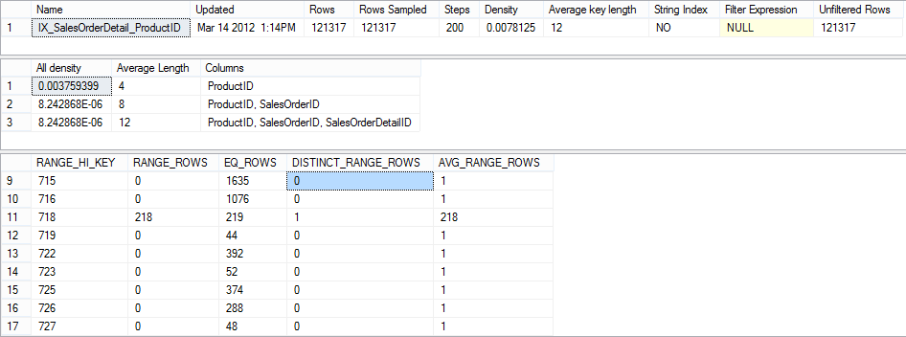
Statistics?
Notes:
This output is shown using DBCC SHOW_STATISTICS. The first row shows some basic information about the table and the number of rows which were sampled when the statistic was created. The second recordset shows the columns in the statistic (as well as within the index that the statistic is built on) as well as the average length of these columns. The third recordset shows the ranges of the values which the statistic contains. The RANGE_HI_KEY column contains the value from the first column of the index. The RANGE_ROWS tells you how many rows there are between the value in the RANGE_HI_KEY column and the next value. The EQ_ROWS column tells you how many rows there are in the statistic which have the same value as the RANGE_HI_KEY value. Out of all this information the most important value to look at is the Updated column of the first recordset. This tells you when the last time the statistic was updated. If the table is updated very frequently and performance is inconsistent, and the value in the Updated column is very old, manually updating the statistic might be required.

Slide 19

Compression
Saves space within:
The database
Memory
Backups
Costs CPU speed, but usually worth it
Data Compression is Page or Row
Backup Compression is an on or off
http://www.flickr.com/photos/aussiegall/316350537/
Notes:
Data compression is an Enterprise only feature so it is only available when using the Enterprise Edition of SQL Server 2008 and up. Backup Compression was introduced in SQL Server 2008 as an Enterprise Edition feature, but in SQL Server 2008 R2 it was changed to a standard edition feature.

Slide 20

Corruption
All databases can become corrupt
Corruption is usually a hardware problem
Corruption should be checked for regularly
Depending on what is corrupt it may be repaired without data loss
Corruption is checked for and repaired using DBCC CHECKDB
Corruption will happen, how you prepare for it will determine how easily you can survive it
Some corruption can’t be repaired and must be restored from a backup
http://www.flickr.com/photos/posterboynyc/6321014425/
Notes:
Starting with SQL Server 7, 99.99% of corruption is problems with the storage (disks, cables, drivers, etc.) 0.005% of corruption is bad RAM. 0.005% of corruption is bugs within SQL Server.

Slide 21
Compatibility Level
Compatibility levels tell SQL Server which language syntax to support
Does not effect the version of the SQL Server the database can be restored to
SQL Supports several down level compatibility levels.
SQL 2014 supports SQL 2008 and up
SQL 2012 supports SQL 2005 and up
SQL 2008 R2 and below support SQL 6.5 and up
http://www.flickr.com/photos/eyesplash/4121161376/

Slide 22
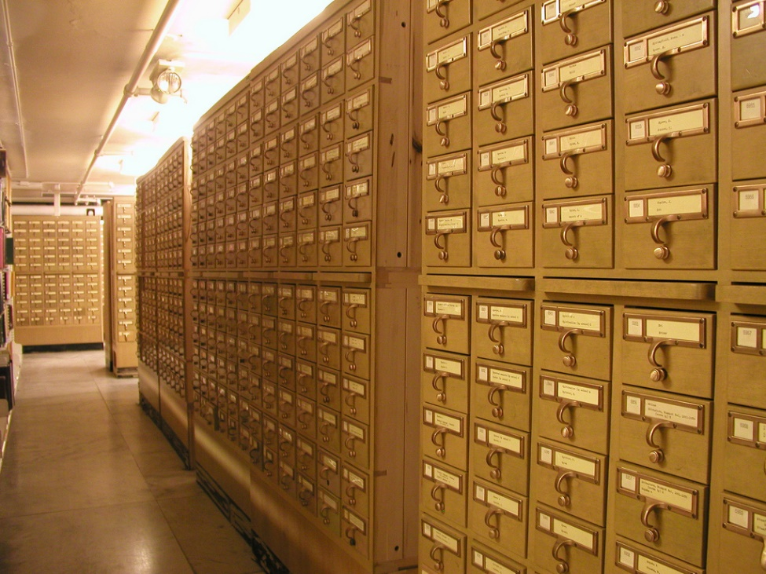
Indexes
Used to speed up queries
Sorted based on the columns within the index
Causes duplicate data to be stored
Trades space for speed
Indexes are ½ art and ½ science
http://www.flickr.com/photos/annarbor/4350627292/
Notes:
An index is sort of like the card catalog in the library. If we imagine that each book in the library is a row within a table, we need a way to find the right book. Most libraries have two card catalogs, one sorted by book name and one sorted by author name. Each of these card catalogs would be an index within the database. If you want to find the book called “Securing SQL Server” you would search through the index which is based on book titles looking for the matching book. If you wanted to find books written by me “Denny Cherry” you would search the author index in order to find my name. In either case using the index will be much faster than scanning through the database table looking for the correct row.

Slide 23

Indexes
Clustered
Nonclustered
Full Text
Spatial
ColumnStore
XML
Semantic Search
http://www.flickr.com/photos/tryingyouth/2456237/
Notes:
These are a few of the different kinds of indexing available within SQL Server. 99% of the time non-clustered indexes will be what you are creating. When creating nonclusterered indexes the indexed columns should be the columns within the WHERE clause with any additional columns such as the columns in the SELECT statement being put into the index as included columns.

Slide 24


Indexes
Notes:
Based on this query, returning the FirstName and LastName columns and searching based on the LastName column we would want to create an index that looks like {click} this index.

Slide 25
Indexes
Notes:
Starting in SQL Server 2008 indexes can be filtered. This makes the indexes shorter as we can exclude rows from the index that we know will never be needed by our queries. Looking at a similar query, this time only looking for active employees with the last name of Cherry, when we create our index we can include only the rows which have the value of 1 in the Active column by adding a WHERE Clause to our index {click} like this. Now filtered indexes aren’t appropriate in every situation, but in some cases they can be very handy to use.

Slide 26
Indexes
Indexes aren’t free
Every index added slows down INSERT/UPDATE/DELETE operations
Only create indexes where the cost of having the index is worth it
Unused indexes can be removed from the database

Slide 27
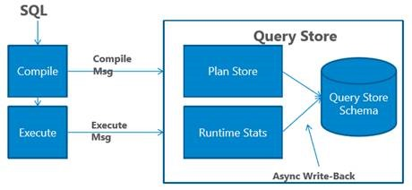
Query Store
Flight data recorder for SQL Server
Identify largest queries
Identify regressed queries

Slide 28

Additional Reading…
http://dcac.co/res/ive-got-a-database

Slide 29











Slide 30
I’ve Got a SQL Database, Now What?
Denny Cherry
mrdenny@dcac.co
www.dcac.co
twitter.com/mrdenny

